Slide 1
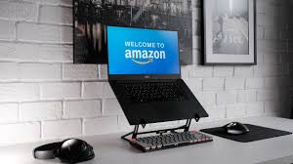
Welcome to Amazon sales! Amazon offers numerous sales events throughout the year, featuring significant discounts through daily deals, limited-time offers like Lightning Deals, and major annual shopping festivals like Prime Day and the Great Indian Festival.

Slide 2

AMAZON SALES DATA
In 2025, Amazon remains the world's largest online marketplace, with independent third-party sellers now accounting for over 60% of all sales in the store. Global net sales revenue reached approximately $638 billion in 2024, with continued growth reported in the first ten months of 2025.

Slide 3
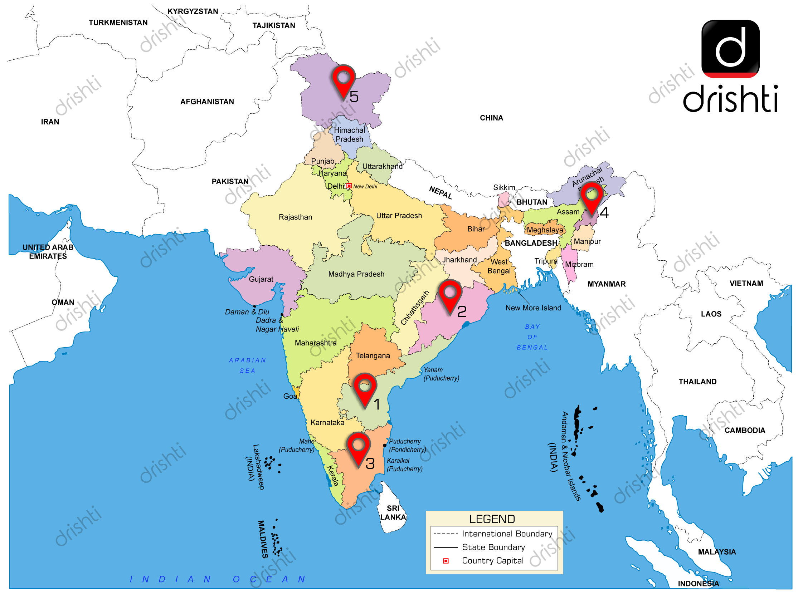
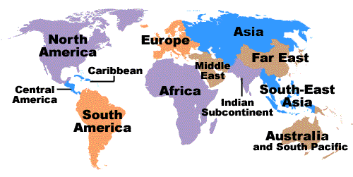
As of 2025, Amazon Web Services (AWS) operates in numerous geographic regions worldwide. Each region is a physical location containing multiple, isolated Availability Zones (AZs)

Slide 4

Amazon's offline/online strategy, particularly in India, focuses on bridging the gap with programs like Local Shops on Amazon (digitizing neighborhood stores for faster local delivery and digital reach) and Smart Stores

Slide 5
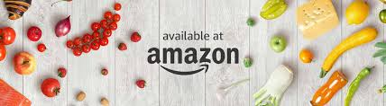

The Amazon rainforest is home to hundreds of edible fruit species, known for their unique flavors and high nutritional value, including powerful antioxidants, vitamins, and healthy oils. Popular examples include açaí, cupcake, and Camu Camu.
Today, Amazon's book presence is dominated by its massive online store (Amazon.in, Amazon.com), diverse categories like fiction, non-fiction, and Kindle, plus services like Prime Reading, making books a top e-commerce category.

Slide 6
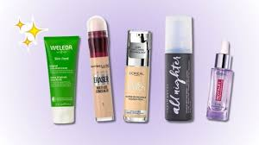
Amazon features daily deals and ongoing discounts on a wide range of skincare and makeup products from popular brands like Cetaphil, Maybelline, and NIVEA. You can find current sales directly on the Amazon Beauty Offers page.

Slide 7
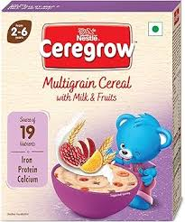
Amazon offers a wide range of baby food products, including infant formula, cereals, puree pouches, and toddler snacks, from popular brands like Nestlé, Slurp Farm, and Apt amil.
Formula is available for various stages of an infant's development, typically categorized by age ranges such as 0-6 months, 6-12 months, and 12-24 months.
Lactogen Pro 1 Powder, Infant Formula Up To 6 Months
  This formula includes probiotics and prebiotics.
Nestlé NAN PRO Stage 1
  This product is an infant formula milk powder designed for babies up to 6 months old, also containing probiotics.
Apt amil Gold Infant Formula Milk Powder

Slide 8
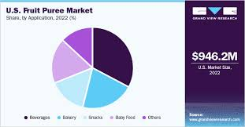
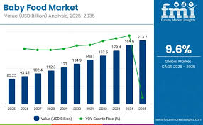
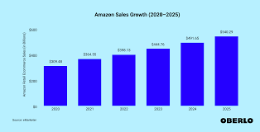
Here is information on popular sales books available on Amazon, details regarding baby food ingredients in makeup products, and an overview of the fruit market for 2025.

Slide 9


